Slide 1
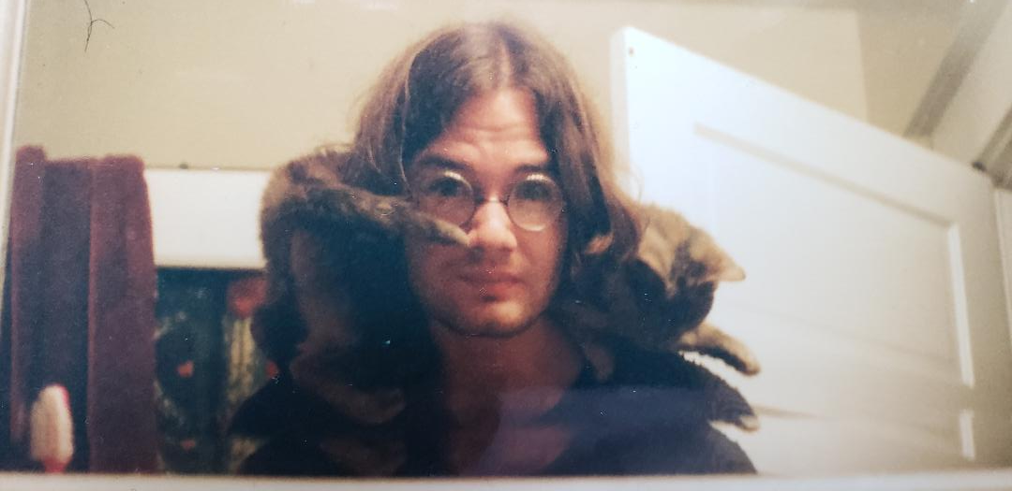
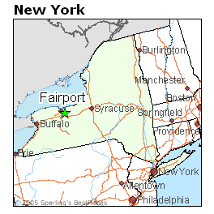
Mr. Jones
Born: 1972
Raised in Fairport, NY
Me, a lot of hair, and a friendly cat, 1995
“Over Descartian vortices you hover.” – Melville, Moby Dick
Engineering and Technology
Important Information About Myself
Sex: Male
Height: 1.8 meters
Weight: Over
Original Hair Color: Brown
Eye Color: Blue
Eyesight: Near
Hand Preference: Left
Blood Pressure: 140/90
Religious Upbringing: Roman Catholic
Marital Status: Single
Home Address: Out of Zone
Handwriting: Awful
Morning Person: No
Credit Card Number: **** **** **** 5384
Education
MAT, Science Education
Augusta State University
Augusta, GA
MS, Meteorology
Florida State University Tallahassee, FL
BA, Creative Writing
Columbia College
Chicago, IL

